Slide 1

AANHPI Heritage Month!
Games & Resources
Let’s play!
Asian Student Alliance

Slide 2
Home
Games
Resources
AAPI Figures
Events
AAPI History
Books
Name that flag
Local Organizations
Finished?

Slide 3

Games
AAPI Figures
Back
There are so many important (and very cool) AAPI figures who play a big role, both in history and modern times.
Test your knowledge with this interactive AAPI Figures trivia!
Play!

Slide 4

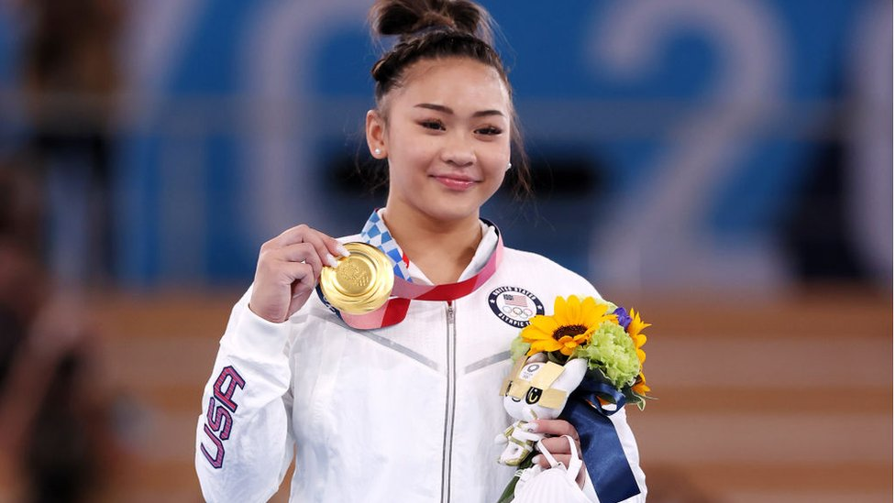
Athletics
Who is a Korean-American snowboarder and two-time Olympic gold medalist?
Next
Click on the correct person!
Chloe Kim
Sunisa Lee

Slide 5
Chloe Kim
Next
At 17, Chloe Kim is the youngest woman to win a gold medal for snowboarding. She has won gold medals at both the 2018 and 2022 winter olympics.

Slide 6
Sunisa Lee
Back
Next
Sunisa Lee is a Hmong American gymnast and the 2020 Olympic all-around champion and uneven bars bronze medalist!

Slide 7
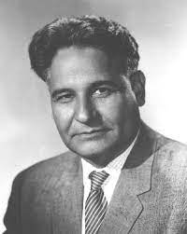
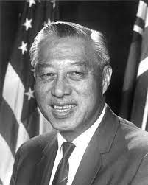
politics
Who was the first Asian American to be elected to Congress?
Back
Next
Click on the correct person
Dalip Saund
Hiram L. Fong

Slide 8
Dalip Saund
Next
Dalip Saund: He was the first person of Asian descent to be elected to Congress in 1957.

Slide 9
Hiram L. Fong
Back
Next
Hiram L. Fong: He was the first Asian American to be elected to Senate in 1959.

Slide 10
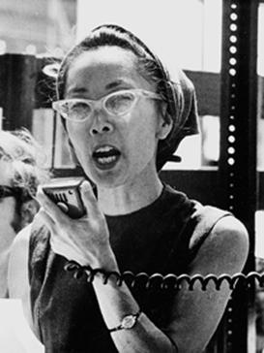
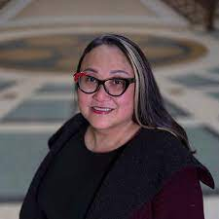
Activism
Which Japanese American is known for her work civil rights after being imprisoned in Japanese internment camps?
Back
Next
Click on the correct figure
Cecilia Chung
Yuri Kochiyama

Slide 11
Yuri Kochiyama
Next
Yuri Kochiyama: This Japanese American woman was interned during WW2 and worked with African and Mexican Americans to champion civil rights

Slide 12
Cecilia Chung
Back
Next
Cecilia Chung: Cecilia Chung is a transgender human rights activist from Hong Kong, advocating for LGBTQ and AAPI equality.

Slide 13
Games
AAPI History
Back
Test your knowledge and learn a bit about the history of Asian Americans in the United States!
Play!

Slide 14
Games
AAPI History
Back
Click on the image of the correct answer choice
Ready?
Start now!

Slide 15

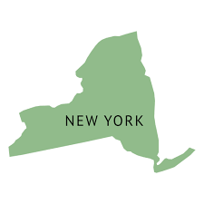
Where did the first Asians arrive in America?
Back
Next
California
New York

Slide 16
california
Next
The first wave of Asian immigration occurred during the California Gold Rush in the 1850s!

Slide 17
Ooops!
Next
Try again!

Slide 18
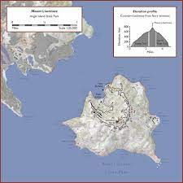
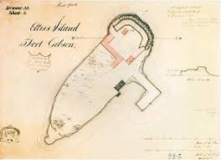
Back
Next
Angel Island
Ellis Island
Which island did most Asian Americans arrive through in the early 20th century?

Slide 19
Angel Island
Next
Angel Island was known as the Ellis Island of the west coast, which is where most Asian Americans immigrated through

Slide 20
Ooops!
Next
Try again!

Slide 21
Games
Geography
Back
There are so many different countries and flags within Asia. All have their own cultures, people, and lifestyle.
Test your knowledge and see if you have match the flag with the country!
Play!

Slide 22
Games
Geography
Back
Click on the image of the correct answer choice
Ready?
Learn more!

Slide 23

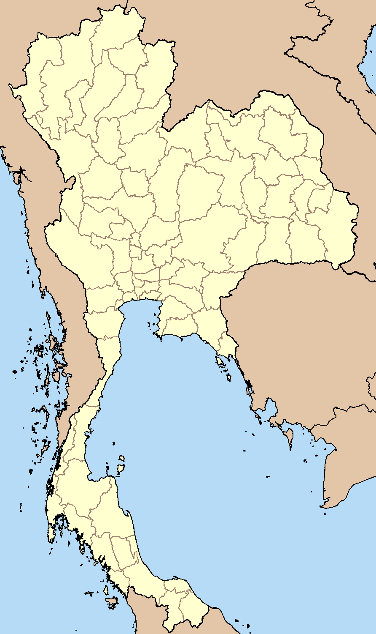
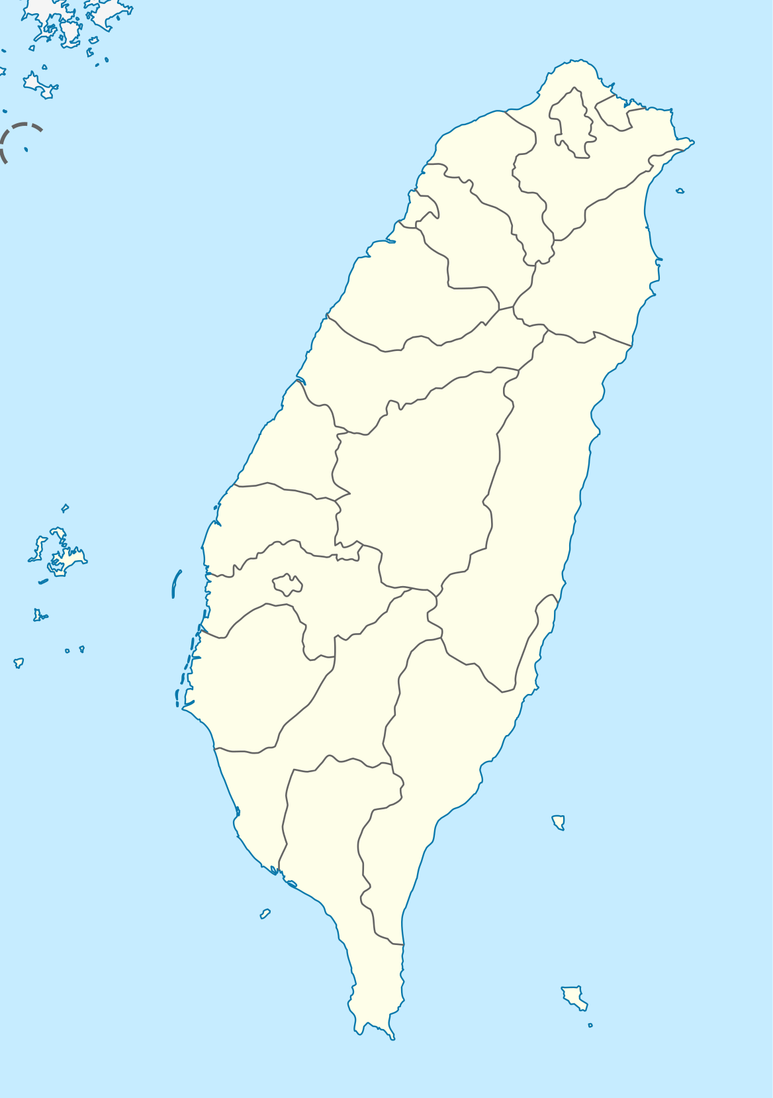
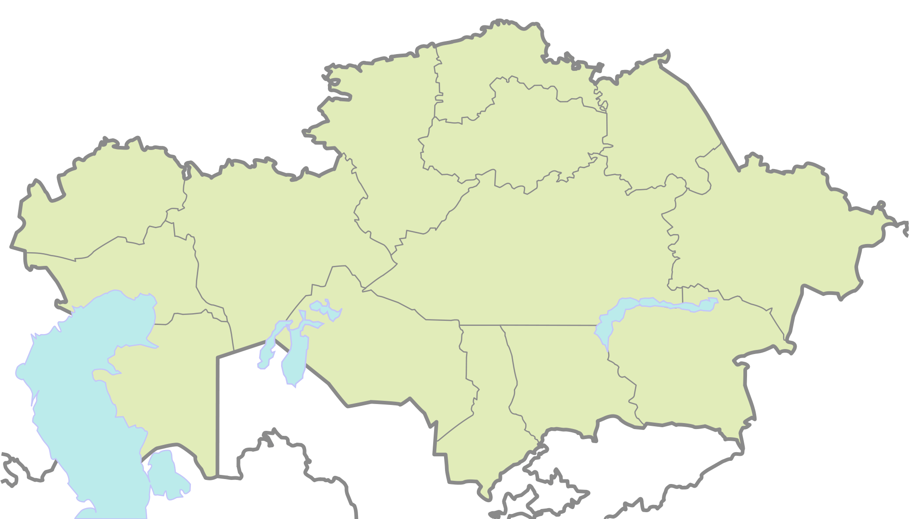
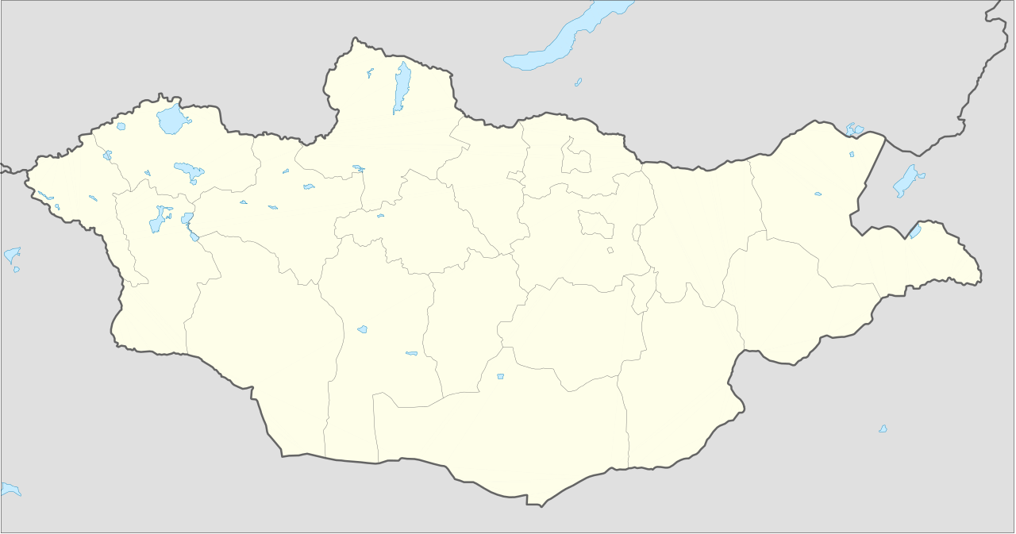
Flags
Back
Next
Click on the country that the flag represents

Slide 24

Taiwan
Next
Fun Fact:
Boba Originated in Taiwan

Slide 25
Ooops!
Next
Try again!

Slide 26

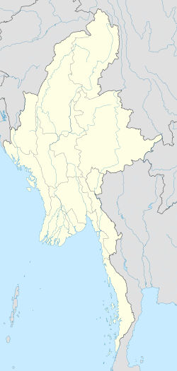
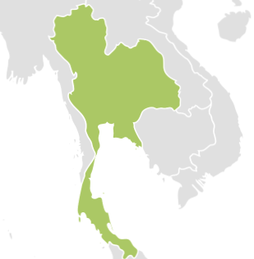
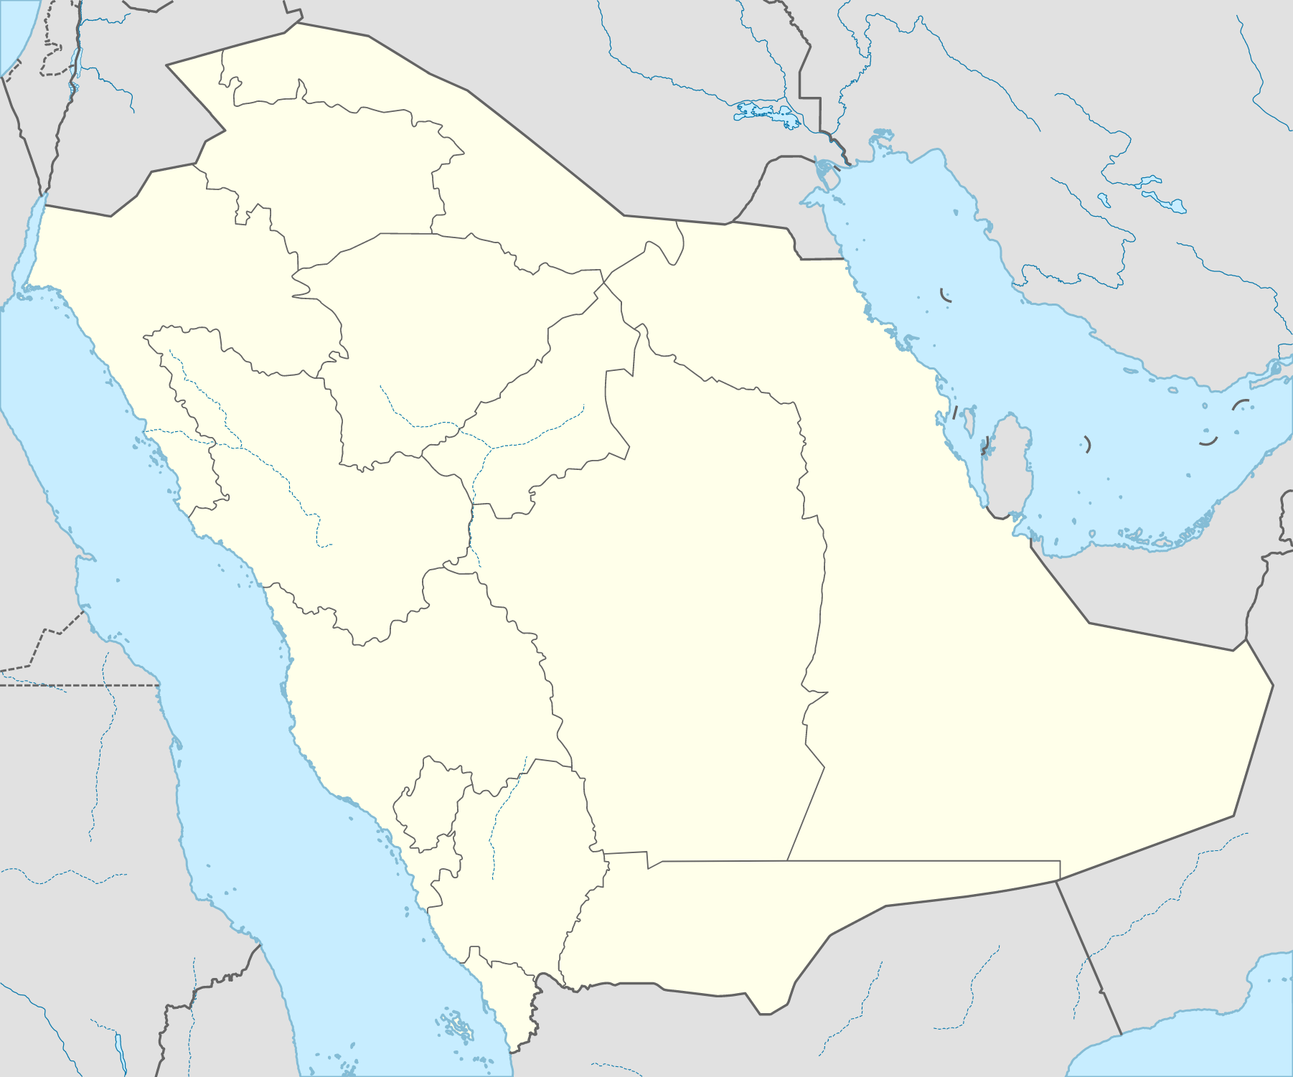
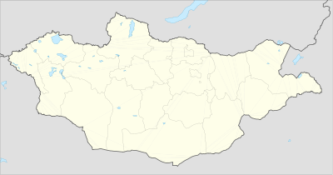
Flags
Back
Next
Click on the country that the flag represents

Slide 27
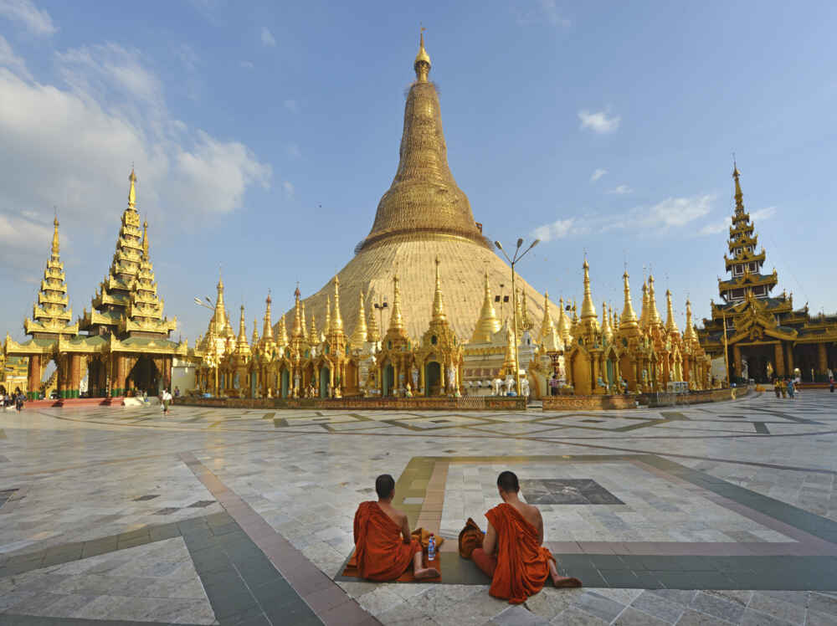
Myanmar(Burma)
Next
Fun Fact: The Shwedagon Pagoda holds a 8 strands of Buddhas Hair

Slide 28
Ooops!
Next
Try again!

Slide 29

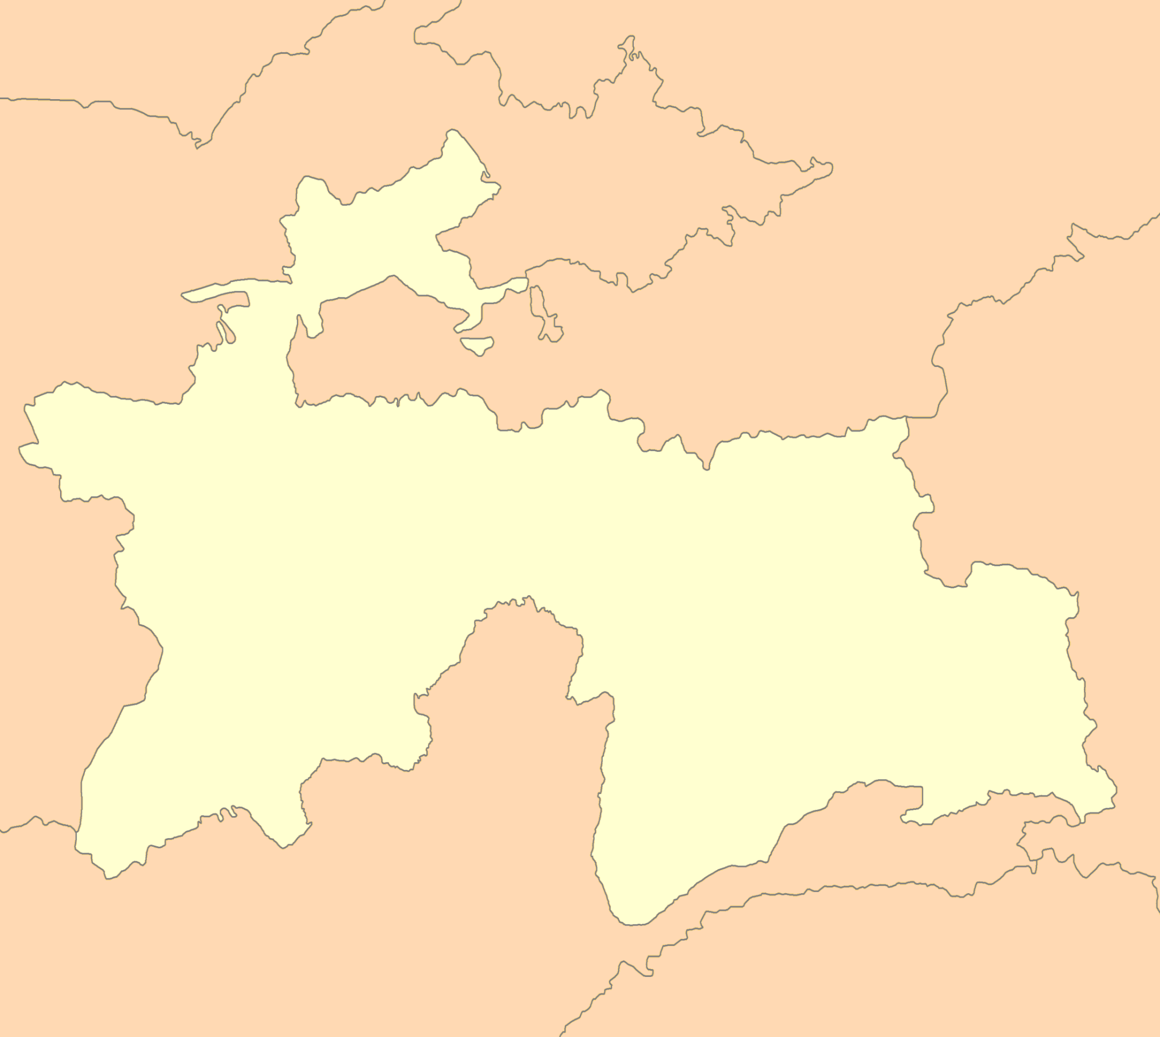
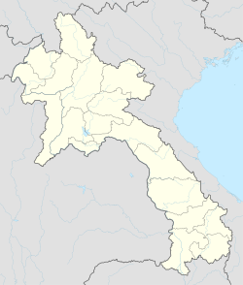
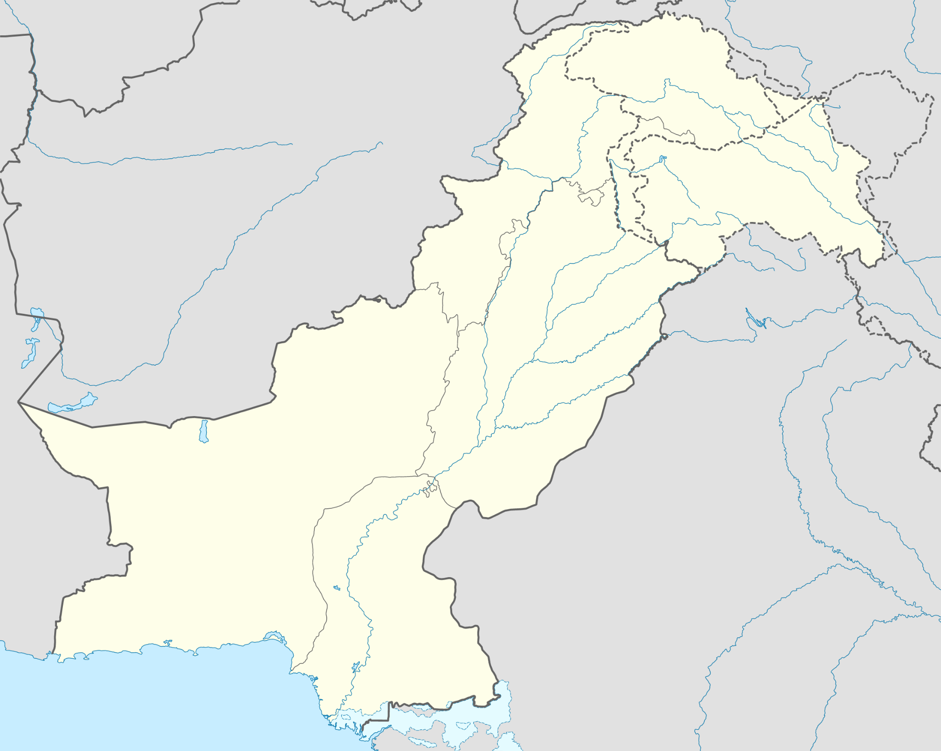
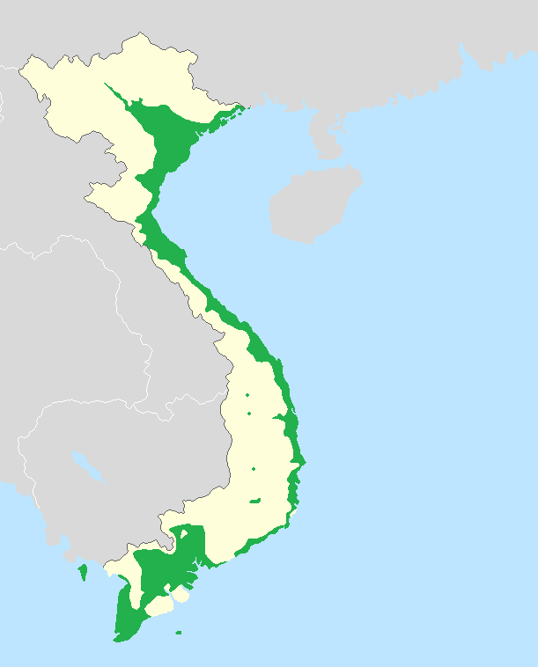
Flags
Back
Next
Click on the country that the flag represents

Slide 30
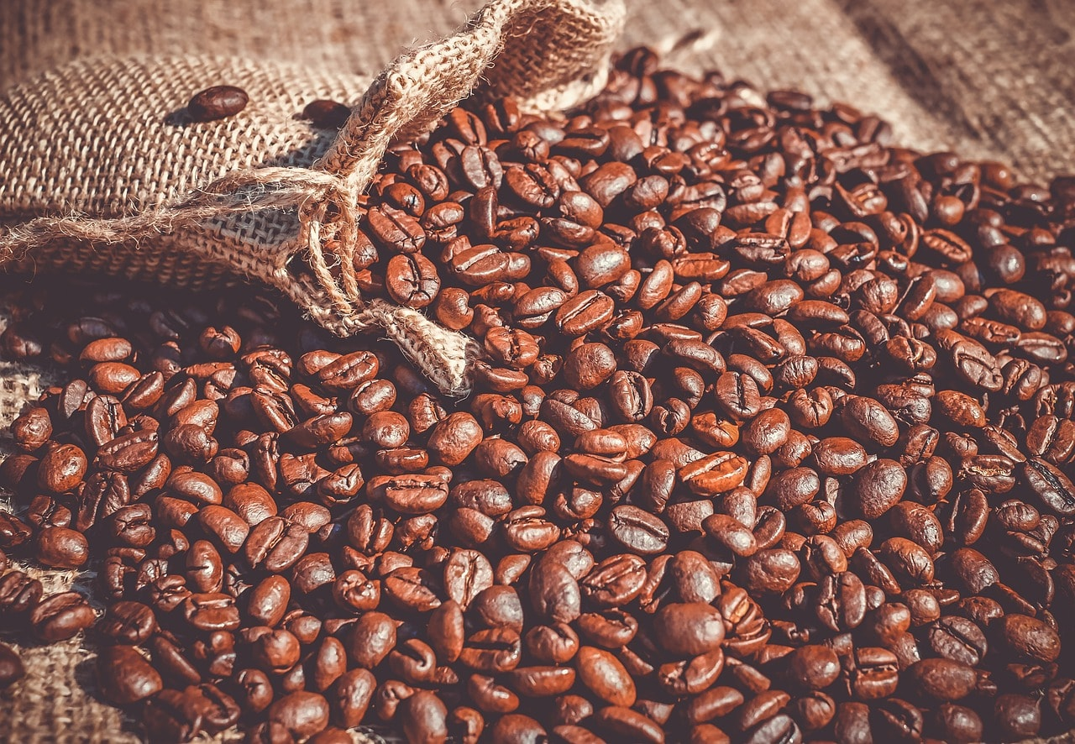
Laos
Next
Fun Fact: Coffee is Laos’ biggest export

Slide 31
Ooops!
Next
Try again!

Slide 32

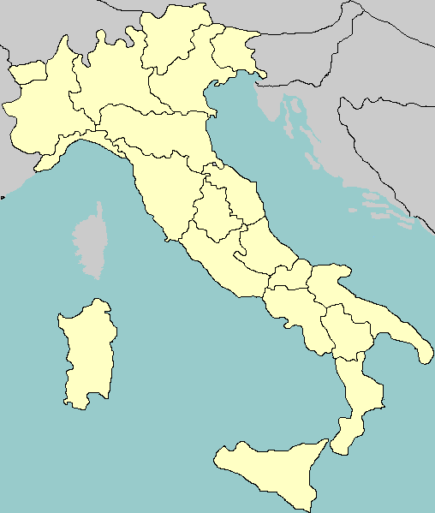
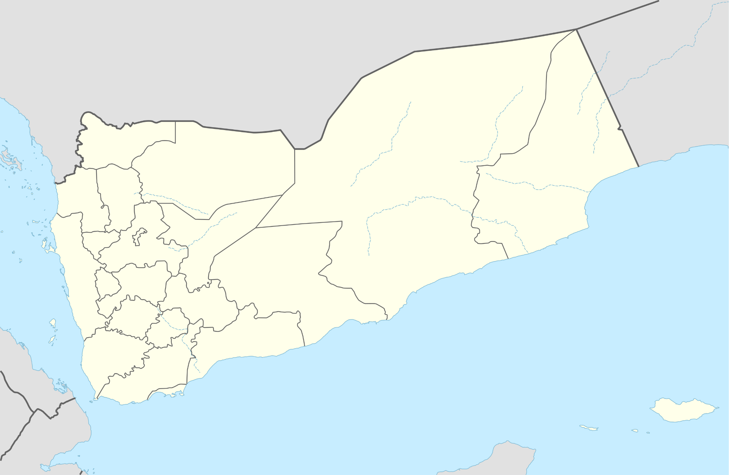
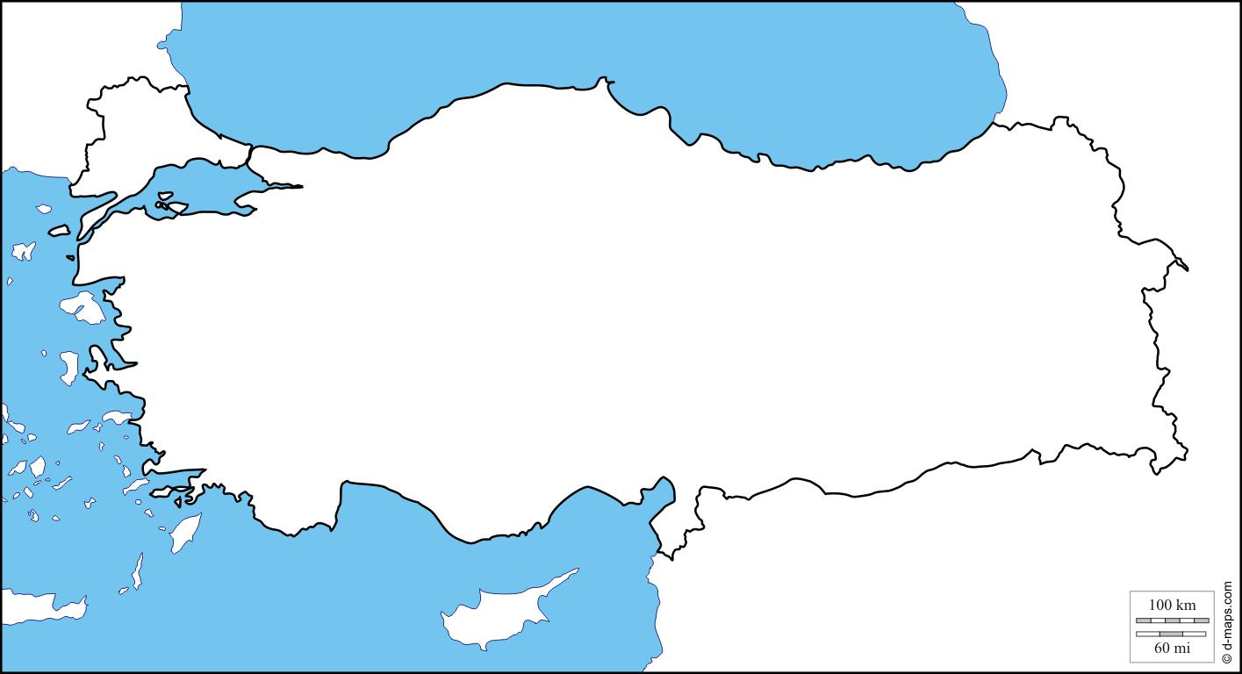
Flags
Back
Next
Click on the country that the flag represents

Slide 33

Yemen
Next
Yemen used to be known as Arabia Felix!

Slide 34
Ooops!
Next
Try again!

Slide 35
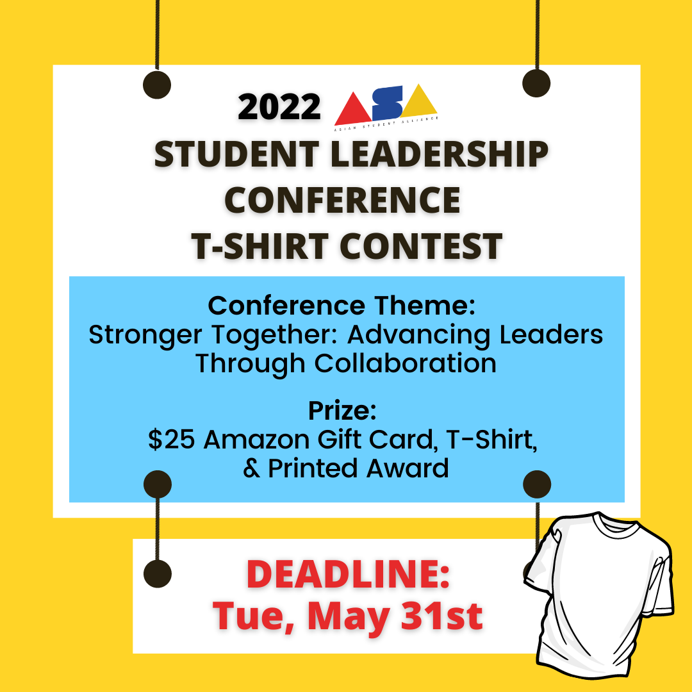
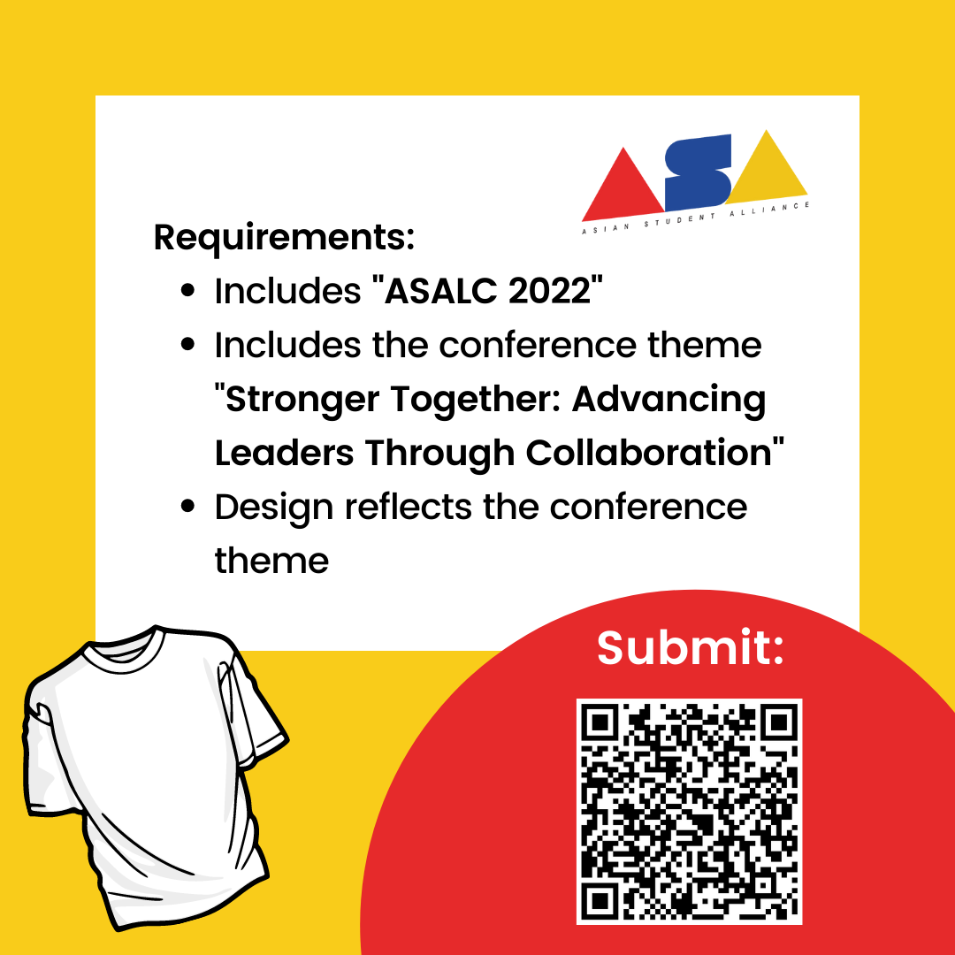

T-Shirt Design Contest
Back
Next
To learn more about the 2022 ASA student leadership conference, visit us at asianstudentalliance.org
Or follow us on Instagram @asianstudentalliance
Submit your
t-shirt design

Slide 36
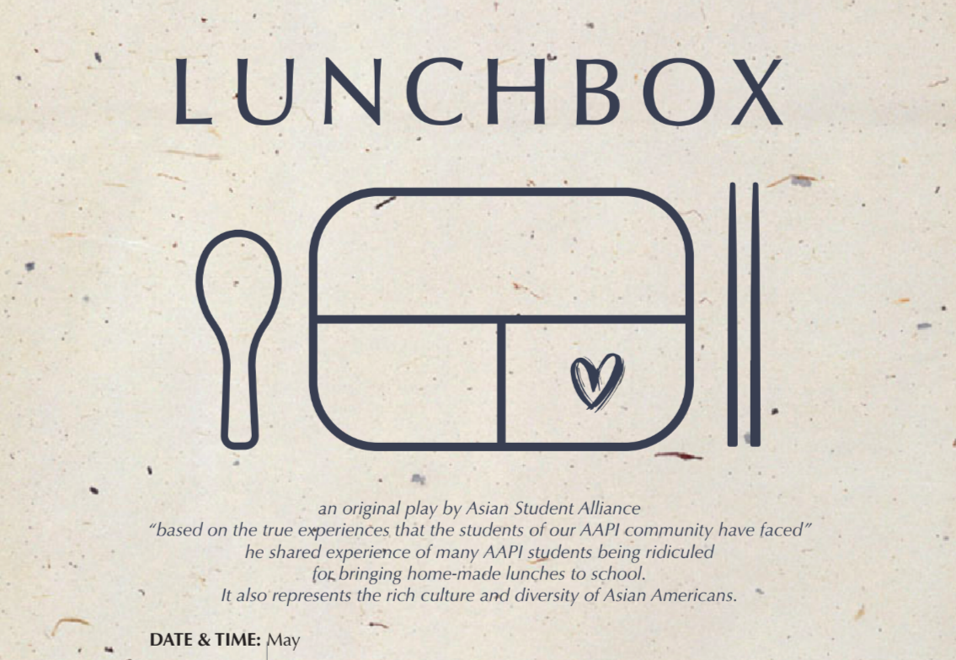
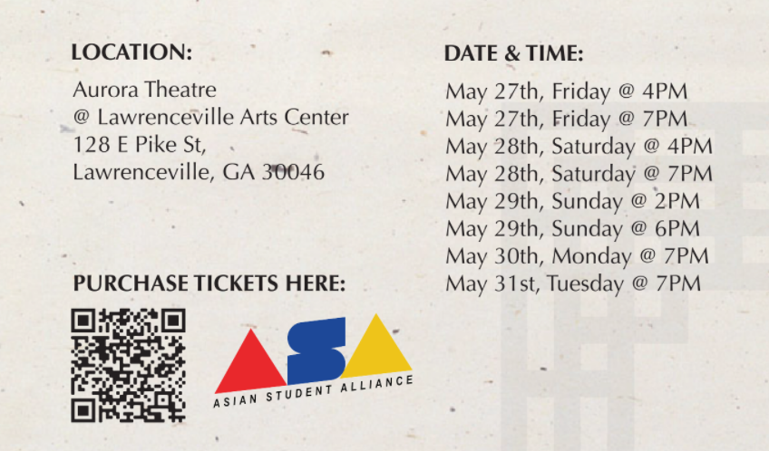
Lunchbox:
An Original play by
Next
Back
To learn more about the play and to purchase tickets, visit: auroratheater.com

Slide 37

AAPI History
is U.S. History
Back
Next
Next
Share and take advantage of this opportunity to learn about incorporating AAPI history into the school curriculum!
Register
now!

Slide 38








Book Recommendations
Back
Next
Books written by AAPI authors are an amazing way to gather an authentic glimpse into the perspective of an Asian American!
Click “next” to see recommendations by age level!
Click on the books to learn more about them and click HERE to see even more recommendations
https://www.penguinrandomhouse.com/the-read-down/books-for-asian-pacific-american-heritage-month/
WHOEVER WORKS ON THIS SLIDE:
Click the link above and pick around four books that look interesting to you (make sure theyre appropriate for students, can be for k-12 doesnt have to be just for elementary/middle school) and put a pick of the title and a short summary for each book on this slide
Thank you you rock
Melodie
(ps also you can take the link at put it at the bottom and say something like “for even more recommendations, click this like” and hyperlink it

Slide 39

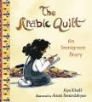


Elementary School
Back
Next
The Arabic Quilt: An Immigrant Story
Aya Khalil
The Name Jar
Yangsook Choi
The Year of the Dog
Grace Lin
Eyes that Kiss in the Corners
Joanna Ho

Slide 40



Middle School
Back
Next
The Love and Lies of Rukhsana Ali
Sabina Khan
Full Cicada Moon
Marilyn Hilton
Almost American GIrl
Robin Ha

Slide 41



High School
Back
Next
It’s Not Like It’s a Secret
Misa Sugiura
The Downstairs Girl
Stacey Lee
The Kite Runner
Khaled Hosseini

Slide 42

Support AAPI Businesses
Next
Back
From eating at AAPI-owned restaurants to shopping at AAPI small businesses, there are so many ways you can show your support for the AAPI community.
To find asian-owned restaurants or businesses near you, go to yelp.com and search “Asian-Owned.”

Slide 43


AAPI Organizations
Back
Next
Whether you are a student, educator, or community member, joining and supporting your local AAPI organizations is a great way to show support for the community! Click on each of the images to learn more

Slide 44
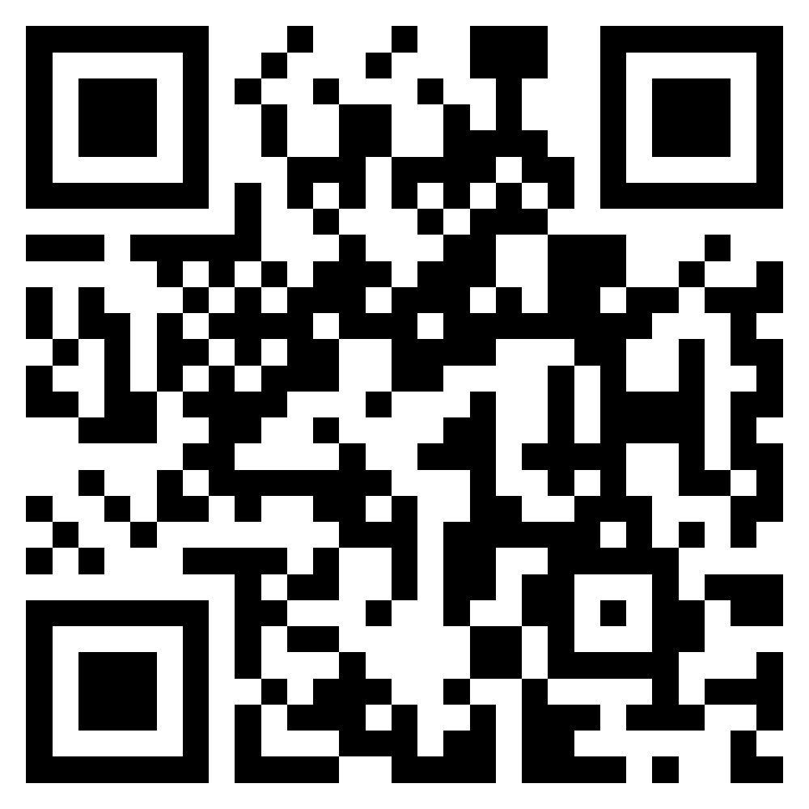
Back
Next
To learn more, visit:
asianstudentalliance.org
Asian Student Alliance, or ASA, is a student-led group that focuses on issues regarding education. This organization strives to increase leadership capacity among students.
ASA is currently working on a play about the often-overlooked experiences of AAPIs as well as a summer student leadership conference! Visit the website to learn more.
Notes:
Add concise info about play & upcoming summer conference

Slide 45
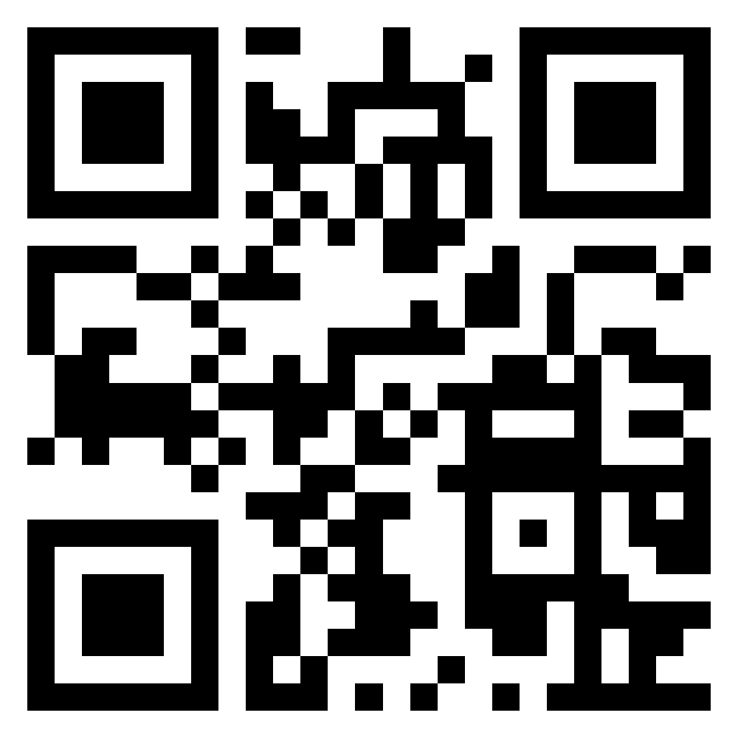
Back
Next
To learn more, visit:
cpacs.org
CPACS, or the Center for Pan Asian Community Services, is a nonprofit organization promoting self-sufficiency and equity for immigrants, refugees, and underprivileged through social and health services, capacity building, and advocacy

Slide 46
GCGA AAPI Celebration
Back
Next
🌏 Join us as Gwinnett County Government celebrate AAPI Heritage Month on Tuesday, May 17 at 6:00pm! 아태계 문화유산의 달 행사에 여러분을 초대합니다. 사전예약 부탁드립니다.
Enjoy riveting performances, great food, and fellowship with our vibrantly connected community.
👉Please register at GCGA.us/AAPICelebration

Slide 47
Thank You!
Presentation by:
Visit us at asianstudentalliance.org
Or follow us on Instagram
@asianstudentalliance
Every small action counts.
Let’s honor and celebrate
AANHPI Heritage Month together!

